Slide 1


Introduction to shiny app development
December 5, 2020
11:00 am - 2:00 pm

Slide 2
Agenda
Time | Activity | Speaker/Moderator
11:00am – 11:05am | Participants joining
11:05am – 11:10am | Welcoming remarks and introducing the speaker | Maggie Wanjiru
11:10am – 11:30am | Brief introduction to Shiny apps | Dorcas Kareithi
11:30 am – 12:30pm | Practical session | Dorcas Kareithi
12:30 pm – 12:50pm | Discussion and questions | Dorcas Kareithi
12:50 pm – 13:10 pm | Overview of R-Ladies Nairobi meetups in 2020 | Maggie Wanjiru
13:10 pm – 13:20 pm | What we have lined up for 2021 | Maggie Wanjiru
13:10 pm – 13:20 pm | Feedback from participants on the meetups | Maggie Wanjiru
13:30 pm – 13:40 pm | Acknowledgements and closing remarks | Maggie Wanjiru

Slide 3
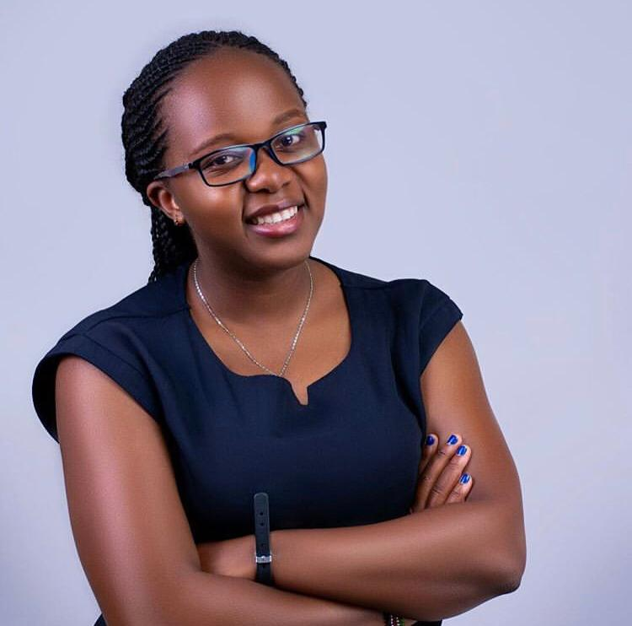
Our trainer
Dorcas Kareithi
Study Design and Analysis Lead, CcHUB Design Lab

Slide 4
Training session

Slide 5
Overview of R-Ladies Nairobi meetups in 2020
R-Ladies Nairobi was launched on 8th August 2020
2020 meetups
Date | Topic | Speaker
05/09/2020 | Data manipulation in R part 1 | Naomi Ngángá
03/10/2020 | Data manipulation in R part 2 | Christine Okeyo
07/11/2020 | Text mining in R | Shelmith Macharia
05/11/2020 | Introduction to shiny app development | Dorcas Kareithi

Slide 6
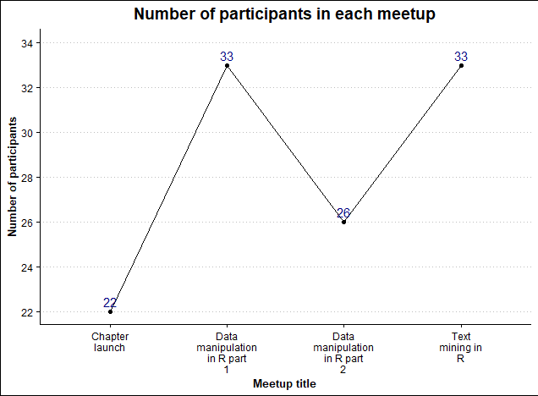
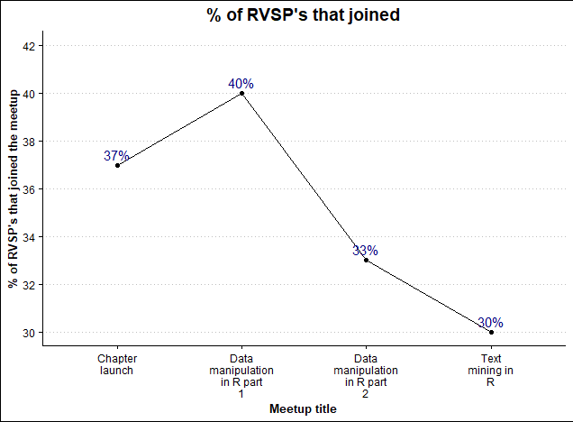
Overview of R-Ladies Nairobi meetups in 2020

Slide 7
What we have lined up for 2021
Monthly meetups from February 2021
Meetup collaborations with other R-ladies groups and R user groups
Participation in data science activities such as hackathons
Reach more R users in Kenya

Slide 8
Feedback from participants on the meetups
Please type on the chat (5 minutes)
How were the meetups?
What should we improve in 2021?
Any suggestion on the speakers and topics?

Slide 9
Acknowledgements and Closing Remarks
Thank you:
R-Ladies Global for the infrastructures
All participants
All speakers

Slide 10
THANK YOU
Email address: nairobi@rladies.org
LinkedIn: R-Ladies Nairobi
Twitter: @RLadiesNairobi
Meetup: https://www.meetup.com/rladies-nairobi/

